Slide 1


Amazon: Revolutionizing Online Shopping
Anthony Meunier
DeVry University

Slide 2
Amazon started as an online bookstore run out of a garage.
Incorporated under name “Cadabara.com” in 1994
Bezos wanted to capitalize on growth of web commerce
Made a list of easily marketable products
Decided to focus on books
Officially changed name to Amazon in 1995
Sales hit $20,000/week after first two months
Began publicly trading @$18 per share in 1997

Slide 3
Today it has 39 warehouses in the U.S. and 44 more in 12 different countries.
First international websites launched in 1998
Began sale of diversified products (beginning with videos)
Survived the dot-com bubble of late ‘90s
Reported first net profit in 2001
Kitchen, travel, apparel, sports, personal care, by 2003
108 million items sold worldwide during holiday season
Helped drive online retail growth in U.S. by 11% despite 2008 recession

Slide 4
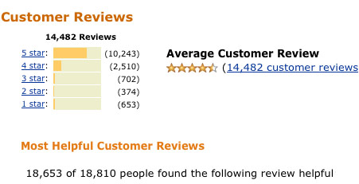
Amazon receives over 600 million website views annually.
65 million customers visit U.S. site each month
Different versions of website for different countries
Has invested heavily on server capacity in order to support traffic to all these sites
User review system in place for every single product sold
Website includes content search option of over 300,000 books

Slide 5
Third-party sellers account for nearly 40% of sales.
Amazon.com auctions launched in 1999 and eventually evolved into the Amazon Marketplace
Started as a way to let customers sell used products, including books, CDs and DVDs
Referral service called “Amazon Associates” that allows websites to earn commission for referring visitors to Amazon
Businesses can sell on Amazon.com and can also have their products stored in and shipped from Amazon warehouses

Slide 6
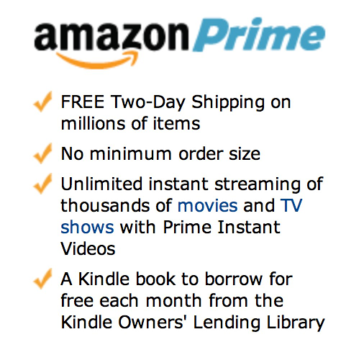
The company has focused efforts in providing industry-changing content and services.
Launched Amazon Prime in 2005
Membership program that provides free two-day shipping for millions of items
Access to other services – Amazon Instant Video, Kindle Lending Library
MP3 store was first to offer DRM-free downloads
Launched Appstore for Android in 2011
AmazonWireless, Amazon Local

Slide 7
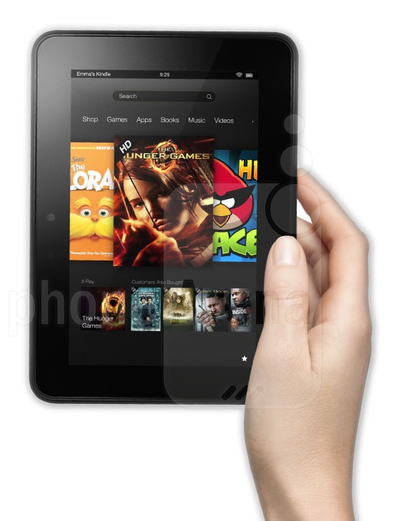
Amazon Kindle serves as the gateway to digital sales.
Launched the Kindle e-book reader in 2007
Entered tablet computer market in 2011 with Kindle Fire
Priced extremely low in order to bolster not only physical sales but also generate interest in digital catalog
E-book sales outnumbered sales of hardcover books starting in 2010
Streaming services are coming in the future to round out catalog of digital content and services

Slide 8
Amazon is dedicated to the growth and support of its company.
Company was founded on unusual business plan
Did not expect to make profit for four to five years
Forward-thinking and investment helped company survive
Gained trust from investors once unconventional plan began to turn profits
Still maintains same attitude today and continues to use majority of revenue on expansion
Always building, expanding, and thinking ahead

Slide 9
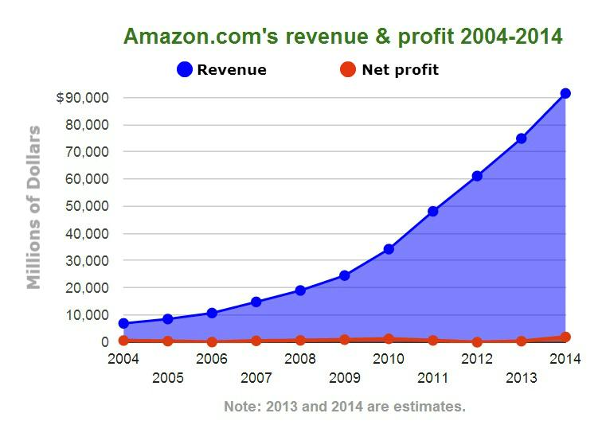
Increasing revenue despite low profit margins.

Slide 10
Where is Amazon taking us next?
AmazonFresh started as a concept idea in 2007
Offers same-day delivery on grocery purchases
Has expanded to include Seattle, Los Angeles, and San Francisco
Recently announced Amazon Prime Air
Delivery drone service
Packages delivered within 30 minutes of ordering
Could arrive as early as 2015

Slide 11
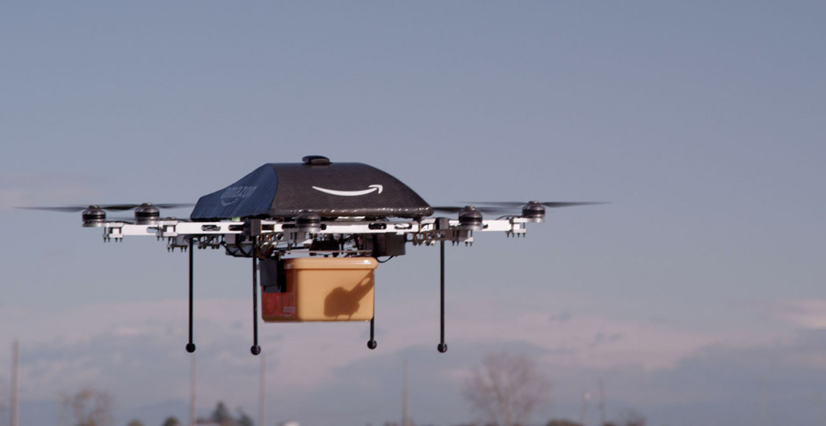
In just 20 short years Amazon has established themselves as a pioneer and revolutionary in the ever-changing, fast-paced world of online shopping.

Slide 12
References
Clark, M., & Young, A. (2013). Amazon: nearly 20 years in business and it still doesn’t make money, but investors don’t seem to care. Retrieved from http://www.ibtimes.com/amazon-nearly-20-years-business-it-still-doesnt-make-money-investors-dont-seem-care-1513368
Guarini, D. (2013). Amazon reveals it wants to deploy delivery drones. no joke. Retrieved from http://www.huffingtonpost.com/2013/12/01/amazon-prime-air-delivery-drones_n_4369685.html
Steinberg, J. (2014). This is how amazon looks historically. Retrieved from http://seekingalpha.com/article/2116073-this-is-how-amazon-looks-historically
Stone, B., & Aley, J. (2013). Amazon’s Jeff Bezos doesn’t care about profit margins. Retrieved from http://www.businessweek.com/articles/2013-01-08/amazons-jeff-bezos-doesnt-care-about-profit-margins
Webley, K. (2010). A brief history of online shopping. Retrieved from http://content.time.com/time/business/article/0,8599,2004089,00.html

